Slide 1
a Humana Inc, subsidiary
iCare Guide for Mental/Behavoral Health and Substance Abuse CLAIMS PROCESSING OVERVIEW

Slide 2
Disclaimer:
This information is provided as a courtesy from iCare to assist you with claims submission and billing. This does not replace Forward Health and CMS Guidelines. iCare relies upon Forward Health and CMS for payment rules and regulations for claim submission.

Slide 3
MH/BH and AODA Authorization
MH/BH and AODA services which require prior notification or authorization include:
• Inpatient hospitalization
• Partial hospitalization
• Intensive outpatient program
• Psychological testing greater than 4 hours
• In-home treatment
• Community day treatment
• Crisis stabilization
Prior authorization and outpatient notification forms are available on the iCare provider website at http://www.icare-wi.org/providers/forms.aspx or can be obtained from an iCare behavioral health staff member at 1-855-893-0476.

Slide 4
Prior Authorization Cont.
Please refer to Prior Authorization Procedure Specific Listing on the iCare website: http://www.icarehealthplan.org/ for services that require prior authorization.

Slide 5
MH/BH and AODA Medicaid Coverage
Visit ForwardHealth Online Handbook @ https://www.forwardhealth.wi.gov/WIPortal/Subsystem/KW/Display.aspx for claim and benefit information on
Adult Mental Health Day Treatment
Behavioral Health Treatment Benefit
Child/Adolescent Day Treatment, Health Check “other services”
Community Recovery Services
Community Support Program
Comprehensive Community Services
Crisis Intervention
In-Home Mental Health and Substance Abuse Treatment Services for Children

Slide 6
MH/BH and AODA Medicare Coverage
iCare follows CMS coverage and claim guidelines
https://www.cms.gov/files/document/medicare-mental-health.pdf

Slide 7
MH/BH and AODA Claims and Coverage Cont.
Outpatient Mental Health
Outpatient Mental Health and Substance Abuse Services in the Home or Community for Adults
Outpatient Substance Abuse
Substance Abuse Day Treatment
Opioid Treatment Program (OTP) Billing:
Proper Billing for OTP Weekly bundles HCPCS codes G2067–G2073 and G2075 and Take Home Medication Codes G2078 and G2079
Date of Service = the first date of care for that week. Do not span “From” and “To” dates. Do not cross months on one claim.
Units of Service – 1 (HCPCS description includes 7 days)
Visit https://www.medicare.gov/coverage/mental-health-care-outpatient for Outpatient Medicare benefits and coverage
Visit https://www.medicare.gov/coverage/mental-health-care-inpatient for Inpatient Medicare benefits and coverage
Medicare Substance Abuse: https://www.cms.gov/Outreach-and-Education/Medicare-Learning-Network-MLN/MLNMattersArticles/Downloads/SE1604.pdf

Slide 8
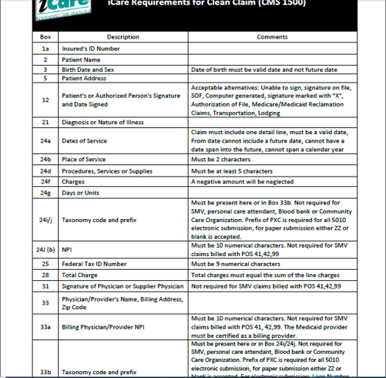
Clean Claim Guidelines – HCFA

Slide 9
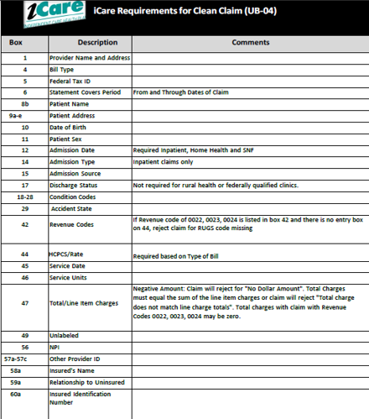
Clean Claim Guidelines – UB04

Slide 10
Claims Filing Limits
Timely filing limits for all providers is 120 days from the date of service, unless otherwise agreed upon and included in the Provider’s service agreement with iCare.
Providers are to submit all claims for services rendered where iCare Medicare is primary or iCare Medicaid is primary according to the terms of the contract. Timely filing limits apply to initial claim submissions, resubmissions and corrected claims.

Slide 11
Claims Submission
Medicare/Medicaid Covered Services
Independent Care Health Plan
P.O. Box 280
Glen Burnie, MD 21060-0280
Long-Term Care Services
Independent Care Health Plan
P.O. Box 670
Glen Burnie, MD 21060-0670
iCare is partner with the claims clearinghouse, SSI Claimsnet, to allow electronic claims submission.
To register with SSI Claimsnet for electronic claims submission via the Internet, click here. Select iCare in the payer drop down box on the registration form to avoid paying any set-up or submission fees for your iCare claims through SSI Claimsnet

Slide 12
Electronic Funds Transfer (EFT) and Electronic Remittance Advice (ERA)
Electronic Funds Transfer (EFT) EnrollmentiCare has joined the InstaMed Network to deliver your payments as free electronic remittance advice (ERA) and electronic funds transfer (EFT). Sign up now to receive iCare payments as direct deposits! ERA/EFT is a convenient, paperless and secure way to receive claims payments. Funds are deposited directly into your designated bank account and include the TRN Reassociation Trace Number in accordance with CAQH CORE Phase III Operating Rules for HIPAA standard transactions. Additional benefits include:
Accelerated access to funds with direct deposit into your existing bank account
Reduced administrative costs by eliminating paper checks and remittances
No disruption to your current workflow — ERAs can also be routed to your existing clearinghouse
You have two simple options to register for free ERA/EFT from InstaMed:
Online: visit www.instamed.com/eraeft
Phone: call us at (866) 945-7990 to speak with a live agent

Slide 13
iCare Provider Portal Access
Your time is valuable. iCare's Provider Portal allows you to view prior authorizations, service requests, verify eligibility and view claim information for the iCare members you serve.
Getting Started
Registration can be completed with information already at your disposal using your TIN (Tax ID Number), NPI and most recent check number. Use the Facility/Group name as listed on your Explanation of Payment. iCare can also generate a one-time PIN, you can request a one-time PIN via the request button below. If you have checks with more than 20 claims processed your will need to request a PIN to register.
If you do not receive your PIN, please contact iCare at ProviderRelationsSpecialist@iCareHealthPlan.org for additional assistance.
If an organization chooses to assign roles for the employees, the Office Manager will need to create a user account for the users within your organization. Office Managers can set up additional users individually and invite them to register or you can create user accounts in bulk via spreadsheet upload.
The iCare Portal User Guide provides step by step instructions for registration and outlines functionalities. If you have any questions, please contact ProviderOutreach@iCareHealthPlan.org or ProviderRelationsSpecialist@iCareHealthPlan.org
Use care when entering your password in the Provider Portal. If the incorrect password is attempted 3 times, your account will be locked. If you are not able to reset your own password or retrieve your forgotten password, email ProviderOutreach@iCareHealthPlan.org or ProviderRelationsSpecialist@iCareHealthPlan.org. Include your Username and your password will be reset within 24 hours.

Slide 14
GENERAL CONTACT/INDIVIDUAL DEPARTMENT PHONE AND FAX NUMBERS
MAIN NUMBER
414-223-4847 or 800-777-4376
Claims/Appeals/Reconsiderations
Local: 414-231-1029
Fax: 414-231-1094
Out of Area: 877-333-6820
Email: Department-providerservices@icarehealthplan.org
Eligibility and Provider Services
Local: 414-231-1029
Fax: 414-231-1094
Out of Area: 877-333-6820
Prior Authorization
Local: 414-299-5539
Out of Area: 855-839-1032
Fax: 414-231-1026
Provider Contracting
414-225-4741
Fax: 414-272-5618

